Slide 1
IBM Spectrum LSF RTM

Slide 2
Introduction:
Introduction to IBM Spectrum LSF RTM - Real Time Monitoring for HPC(High Performance Computing) and big data workloads.
IBM® Spectrum LSF RTM (RTM) is an operational dashboard for IBM Spectrum LSF environments that provides comprehensive workload monitoring, reporting, and management. It makes cluster administrators more efficient in their day-to-day activities and provides the information and tools that are needed to improve cluster efficiency, enable better user productivity, and contain or reduce costs.

Slide 3
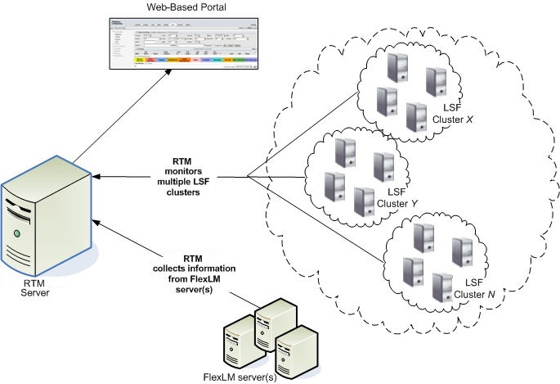
Overview Diagram

Slide 4
IBM Spectrum LSF RTM Overview:
IBM Spectrum LSF RTM offers real-time monitoring and analytics for HPC clusters.
It optimizes resource utilization and proactively addresses performance issues.
Customizable dashboards and alerting capabilities give administrators full control.

Slide 5
Key Features of IBM Spectrum LSF RTM:
Real-Time Monitoring: Live updates on resource usage, job status, and system health.
Customizable Dashboards: Personalized views with graphs and charts.
Job Monitoring: Detailed information on running and queued jobs.
Resource Utilization: Metrics on CPU, memory, and network usage.
Alerting and Notifications: Configurable alerts for critical events.
Historical Data Analysis: Access to historical graphs for trend analysis.
Cluster Overview: Health and performance summary of the entire cluster.

Slide 6
Live Demo:
Accessing LSF RTM Interface
Creating Custom Dashboards
Job Monitoring and Resource Utilization
Alerting and Notifications
Historical Data Analysis
Cluster Overview and Resource Topology

Slide 7
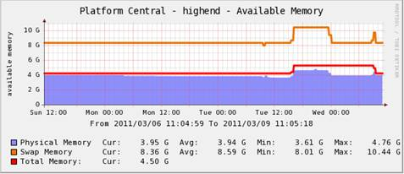
Graphs:
Cluster Graphs : These graph templates show LSF® batch cluster health information on available memory, CPU utilization, IO level, Load Average and Job Statistics over time.
These graph templates shows individual batch host metrics including memory, cpu utilization, IO levels, load averages and job statistics over time.

Slide 8
Conclusion
IBM Spectrum LSF RTM is a powerful tool that empowers administrators with real-time insights, customizable dashboards, job monitoring, and historical data analysis. With its alerting capabilities and integration options, LSF RTM offers a comprehensive solution for optimizing and managing HPC and big data workloads

Slide 9
Q & A

